Slide 1



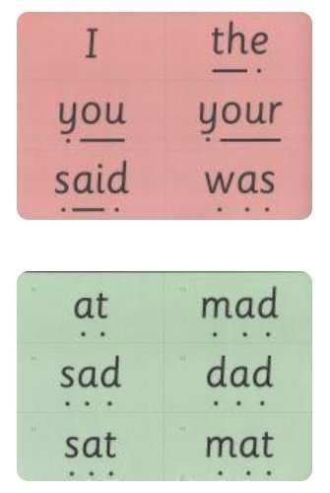
Glossary
New terminology | Definition
Special friends | Two or three letters working together to make one sound e.g. sh, ch, igh, air, a-e, i-e.
Fred talk | sounding out a word, saying each of the sounds before blending
Fred fingers | ‘Pinching’ each sound from a word on your fingers to help spell a word
Green words | Decodable words
Red words | Irregular words that cannot be sounded out
Fred in your head | still sounding out a word but doing so in your head rather than out
Speedy words | decodable words in that children should be able to read
Nonsense words | Alien word which are used to assess children’s knowledge of sounds.

